Slide 1

数字系统设计
14-端到端部署、处理器级并行（ALP）
贾弘洋 & 刘勇攀
2025/05/25

Slide 2
Review
Introduction: CIM to break the memory wall
Memory devices and computational primitives
  Charge-based memory devices: SRAM, DRAM, Flash
  Resistance-based memory devices: ReRAM, PCM, STT-MRAM
SRAM-based CIM: from device to architecture
  3 SRAM CIM primitives: current, charge, digital
  Toward efficient MVM mapping to CIM array: OS, matrix mapping
  Sparsity in CIM: structural sparsity for CIM
  Challenges and Trade-offs in CIM: CIM macro portion, accuracy, etc.

Slide 3
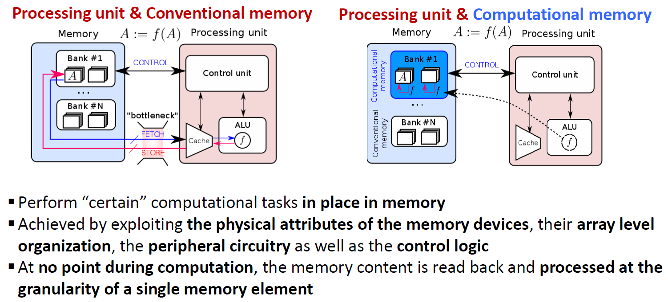
Compute in Memory (CIM)

Slide 4
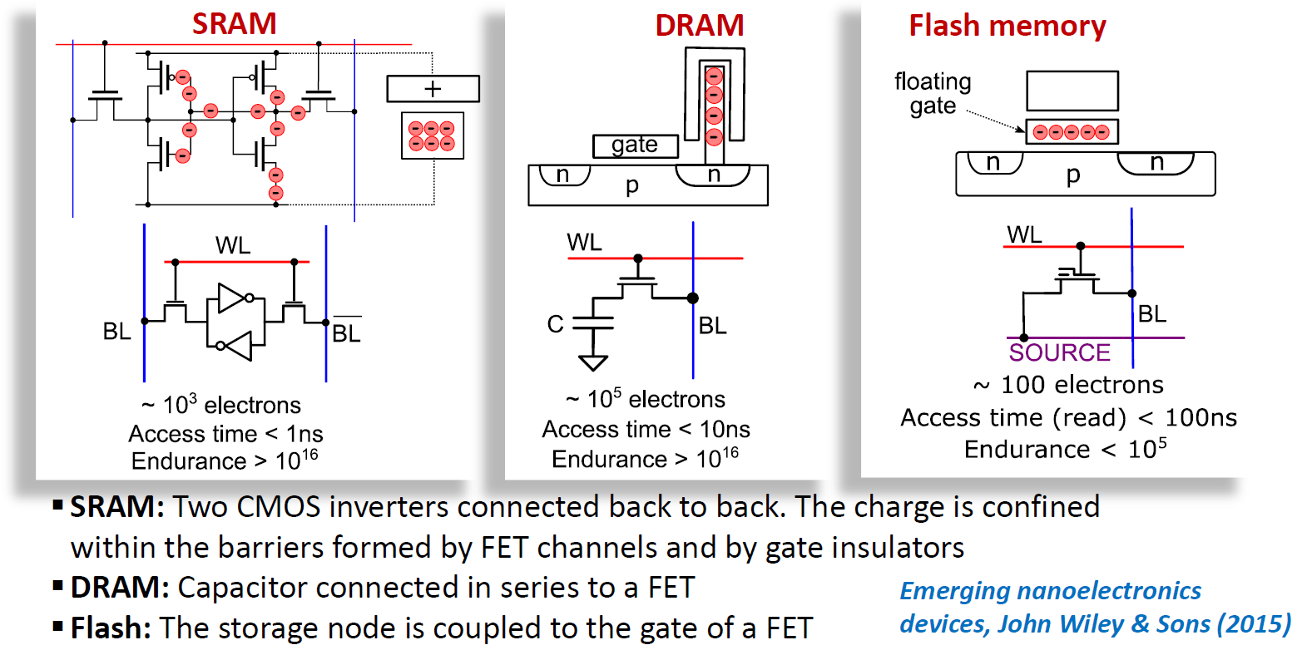
Charge-Based Memory Devices

Slide 5
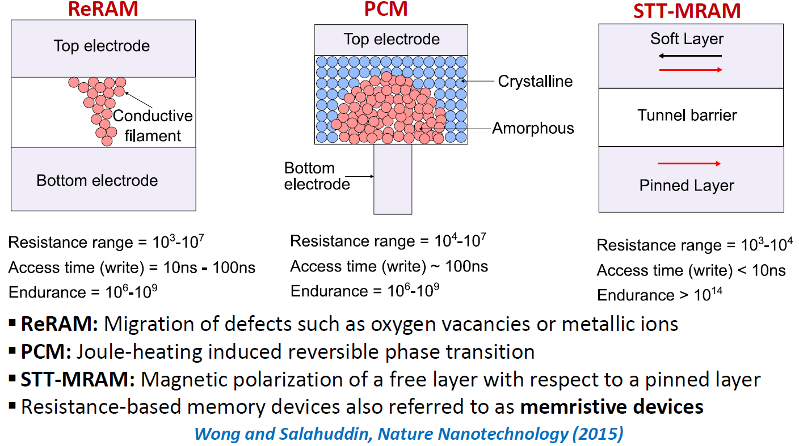
Resistance-Based Memory Devices

Slide 6
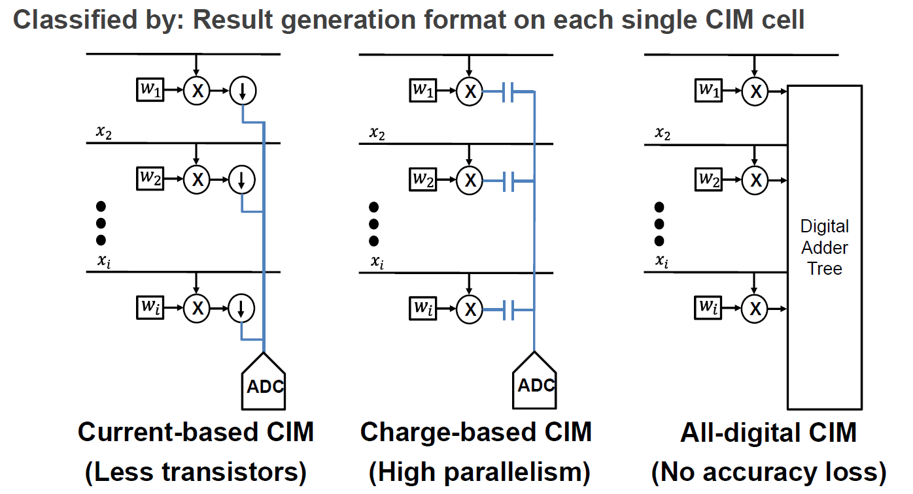
Three Types of SRAM-based CIM

Slide 7
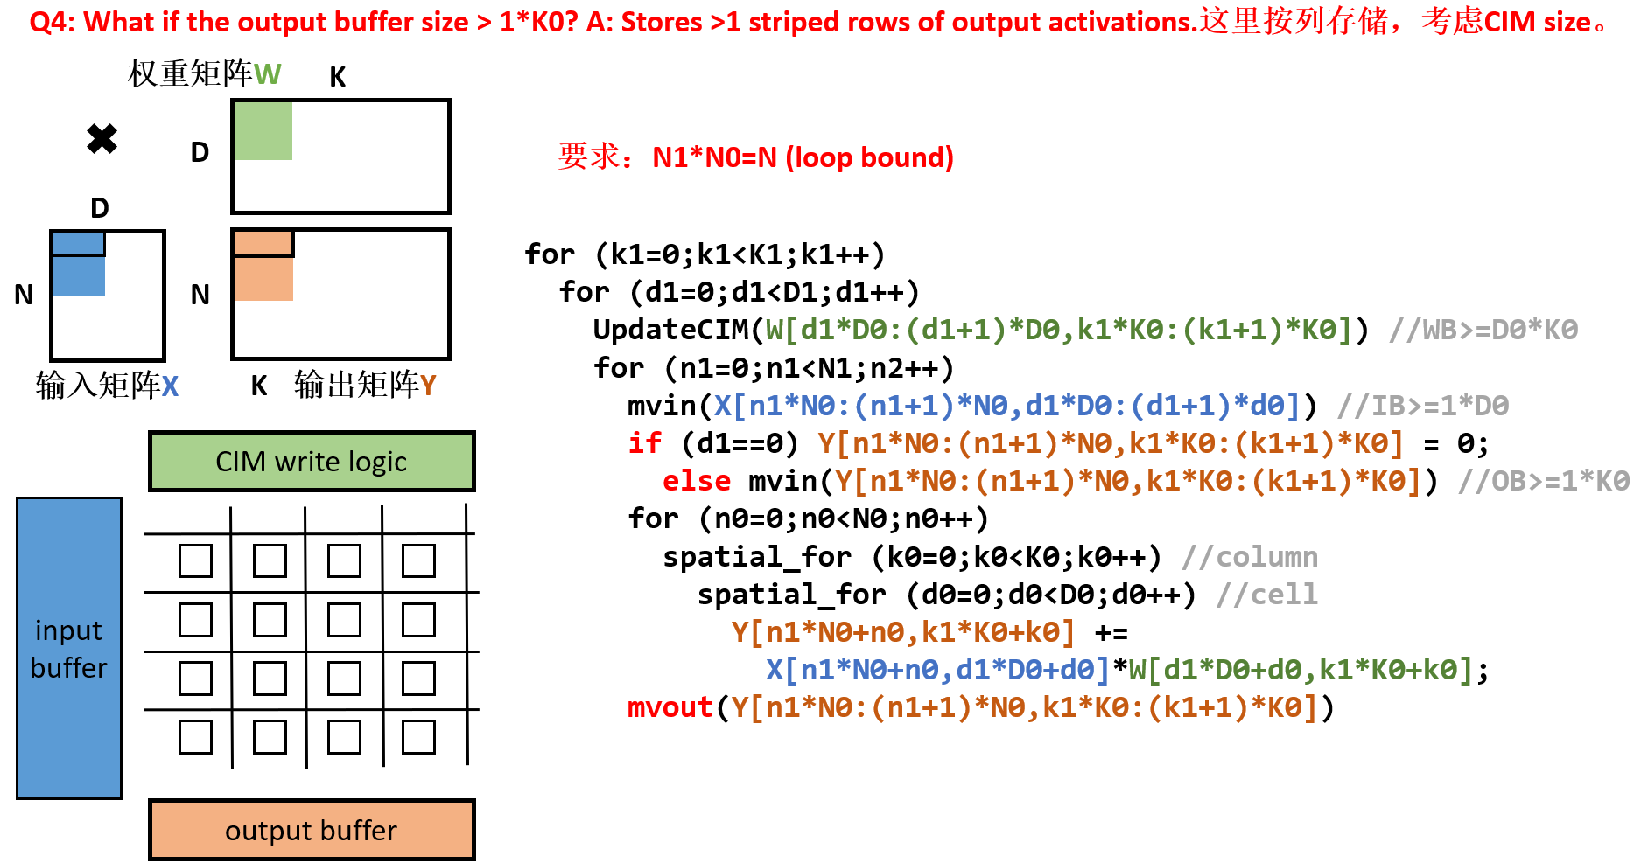

Slide 8
Outline
End-to-End Deployment
  AI Processing Pipeline
  Practical Constraints:
  Thermal, Performance Variability, Interference
Accelerator-Level Parallelism (ALP)
  X-level Parallelism
  ALP in Mobile SoC
  Open Challenges

Slide 9
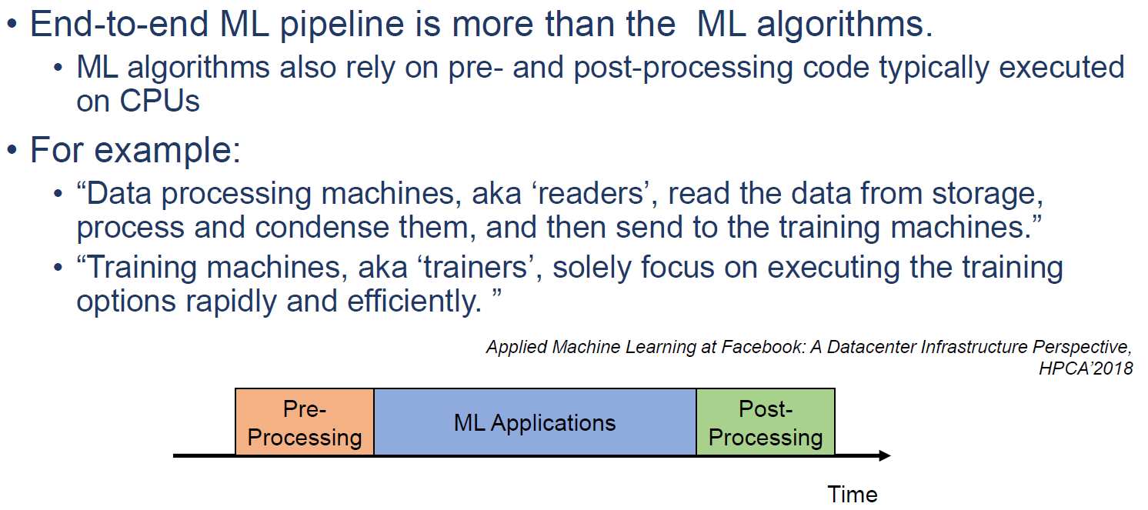
Holistic View of the ML Processing Pipeline
Notes:
有很多的任务还是再CPU上面执行

Slide 10
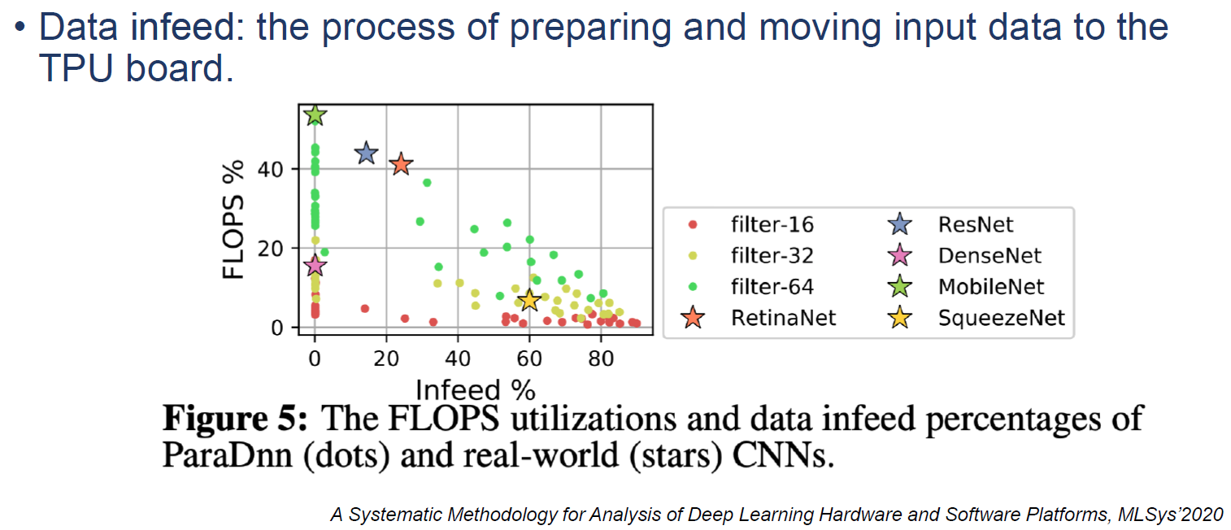
Data Infeed for TPUs
Notes:
讲一下reuse，larger filter-》input reuse
跟什么有关？
各个维度大小，数据是否规律，stride，等等
SqueezeNet：更多关注了计算，用了很多小卷积核
For image datasets, the host fetches images from the network, decodes and preprocesses them, and feeds them to the device. We refer this as data preparation. The device then performs training computation on the images. Data infeed includes network overhead, host compute, and transfer between host and device

Slide 11
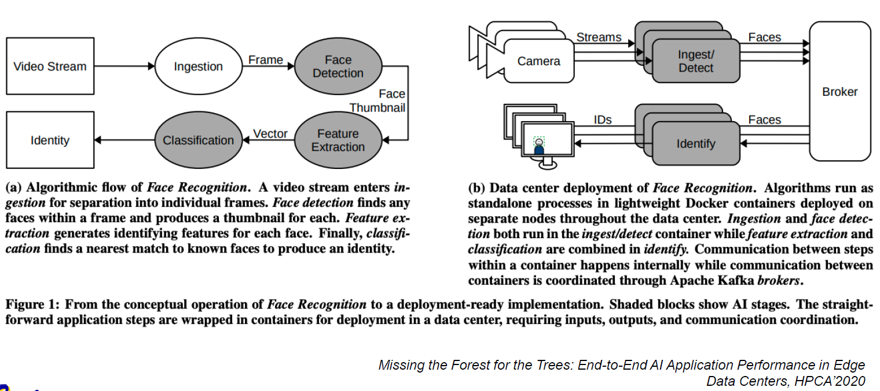
Example: A Face Recognition Pipeline
Notes:
UT Austin Harvard Intel

Slide 12
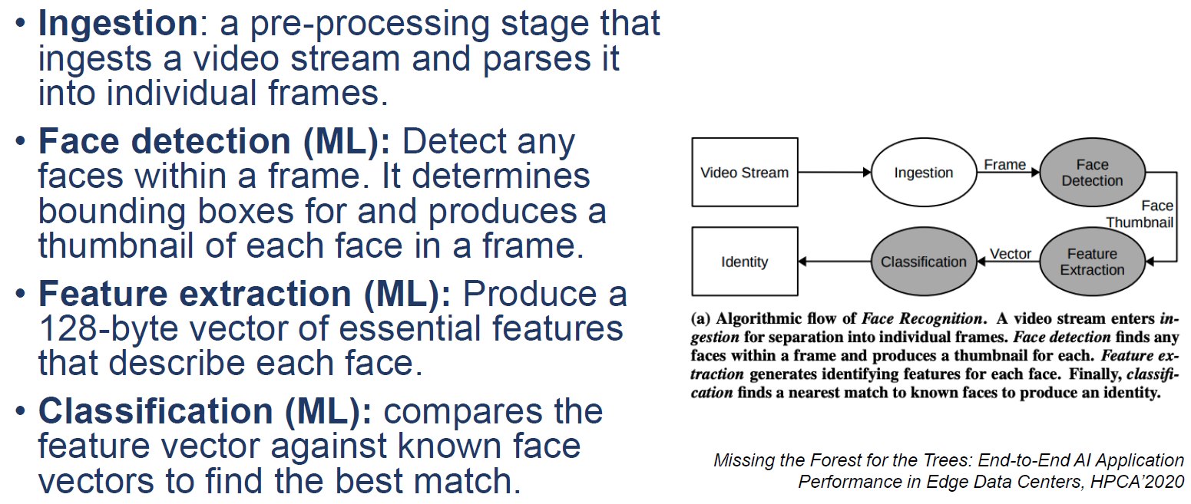
Example: A Face Recognition Pipeline

Slide 13
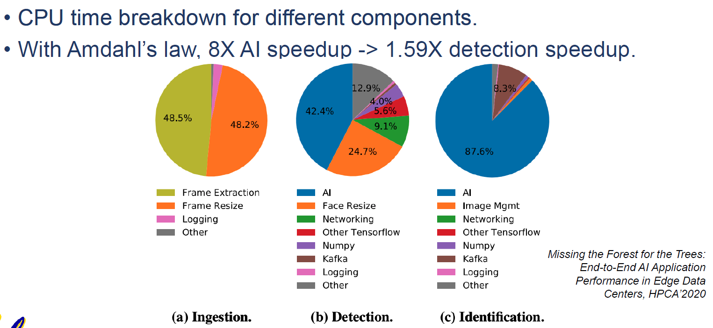
Example: A Face Recognition Pipeline
Notes:
讲一下Amdahl定律
Amdahl’s Law says that if you apply P processors to a task that has serial fraction f, the predicted net speedup is
1/（f+(1-f)/P）
the overall performance improvement gained by optimizing a single part of a system is limited by the fraction of time that the improved part is actually used
1967 Gene Amdahl

Slide 14
Outline
End-to-End Deployment
  AI Processing Pipeline
  Practical Constraints:
  Thermal, Performance Variability, Interference
Accelerator-Level Parallelism (ALP)
  X-level Parallelism
  ALP in Mobile SoC
  Open Challenges

Slide 15
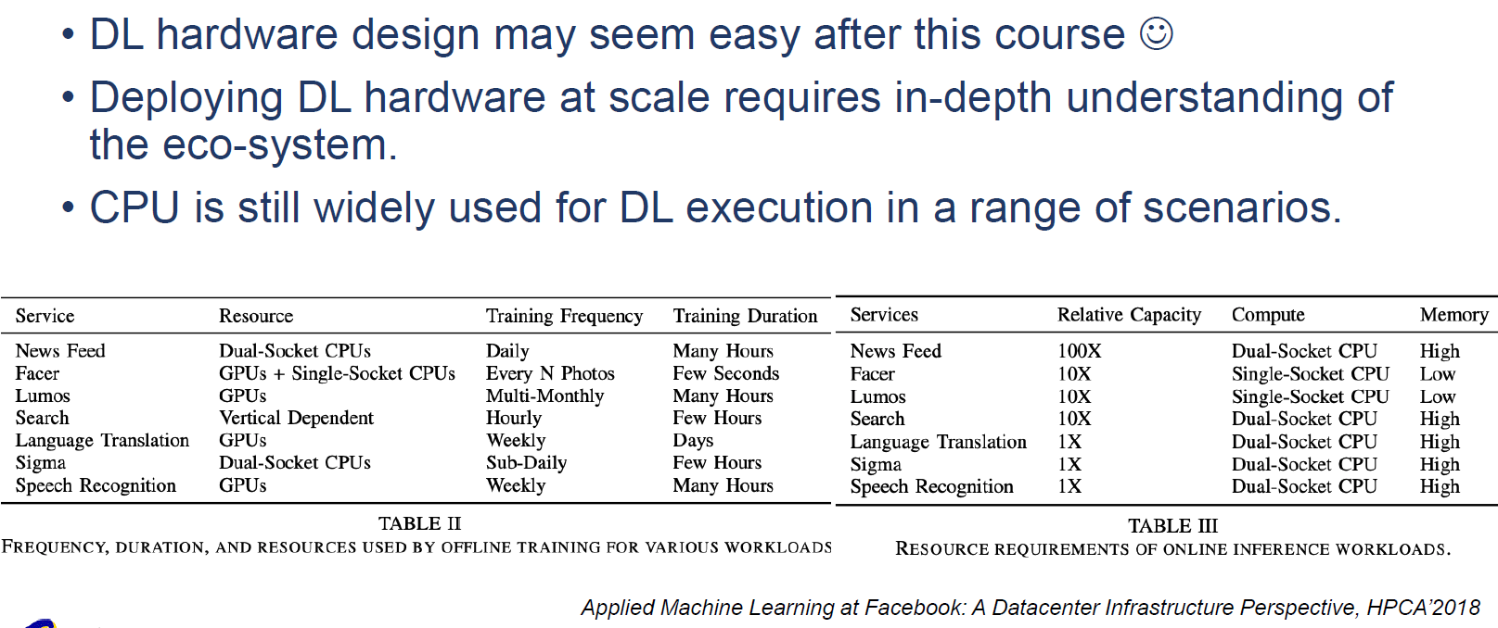
Practical Constraints in Deploying DL

Slide 16
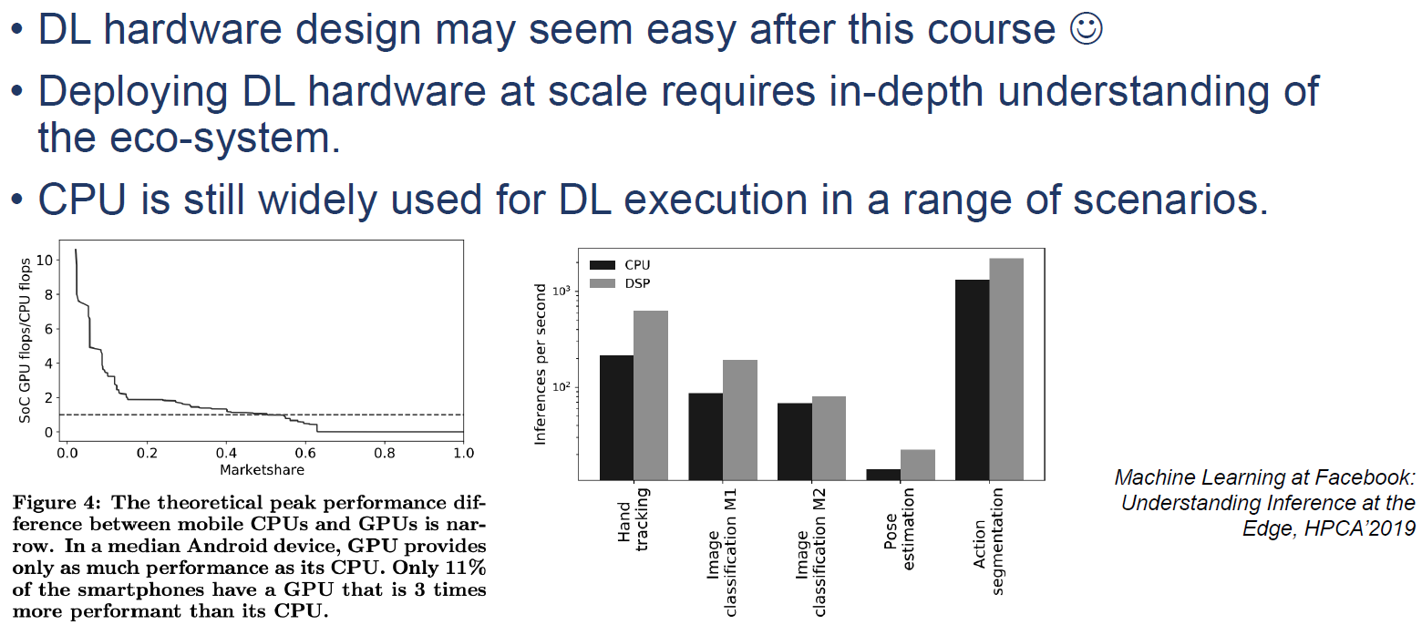
Practical Constraints in Deploying DL
Notes:
Thermal and management所以很多还是bound with CPU

Slide 17
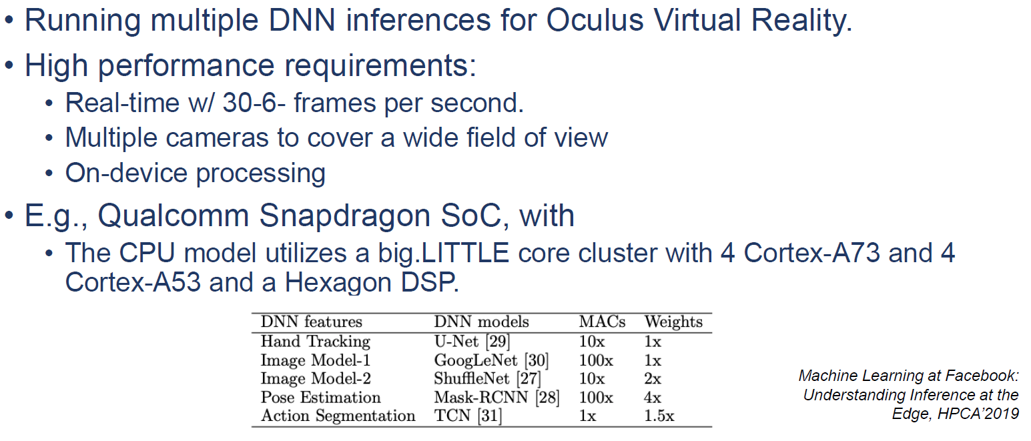
Thermal Constraints
Notes:
脑机接口什么的

Slide 18
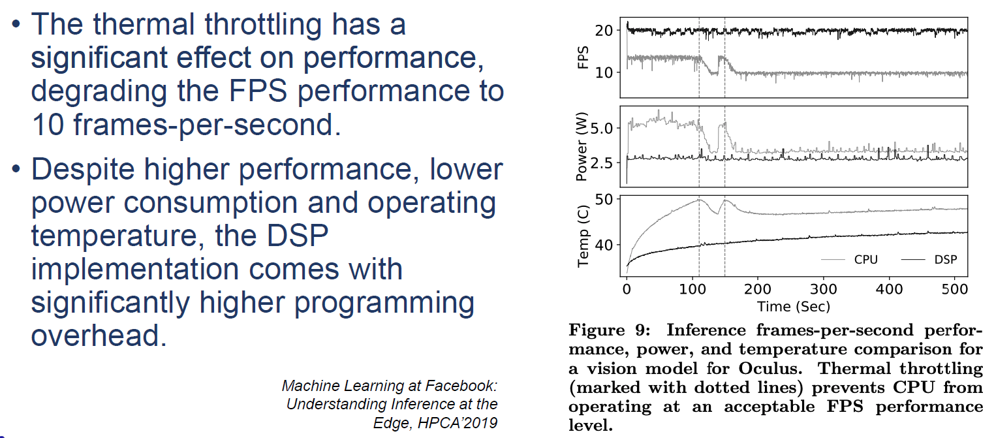
Thermal Constraints

Slide 19
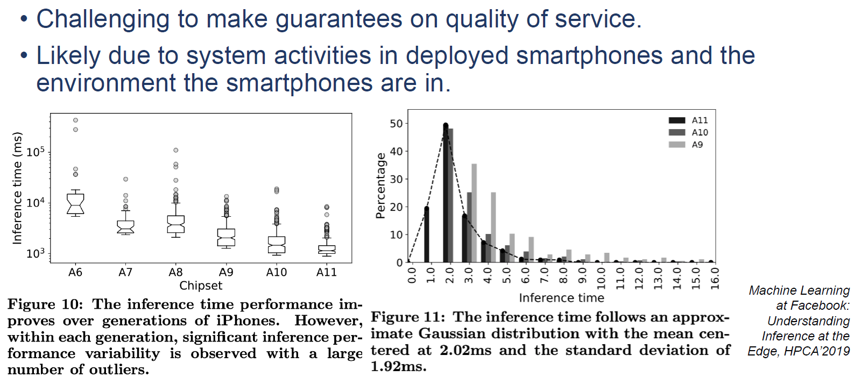
Performance Variability
Notes:
图一 generation内部，不同的使用情况，aging等等
Facebook的工作

Slide 20
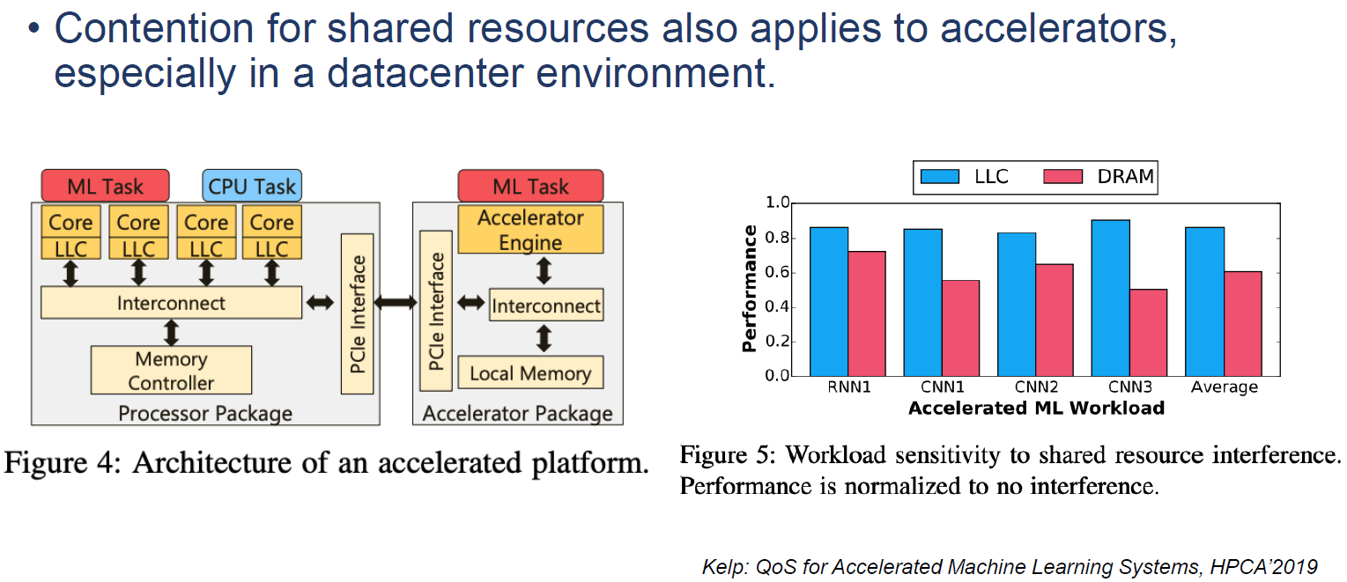
Interference
Notes:
Google的工作
LLC：Last-level Cache

Slide 21
Outline
End-to-End Deployment
  AI Processing Pipeline
  Practical Constraints:
  Thermal, Performance Variability, Interference
Accelerator-Level Parallelism (ALP)
  X-level Parallelism
  ALP in Mobile SoC
  Open Challenges

Slide 22
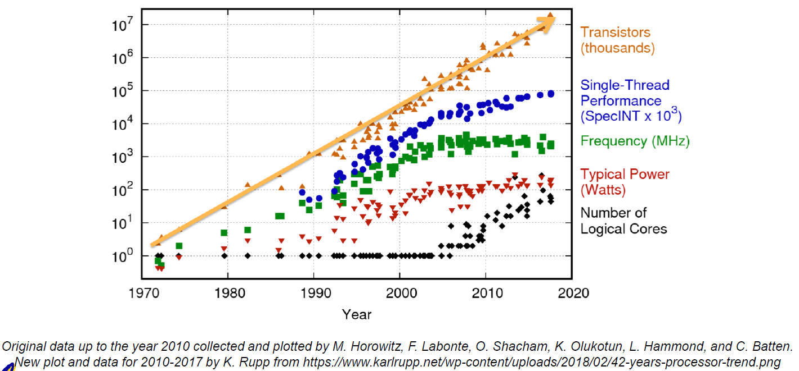
Advances in Processor Performance
Notes:
More transistors
More cores
More heterogeneous cores, not only smartphone. Intel i7 gen 12 13

Slide 23
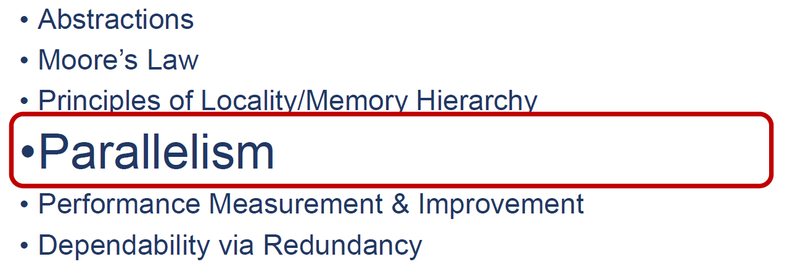
Great Ideas in Computer Architecture
Notes:
所有的加速都是一种并行，大概念

Slide 24
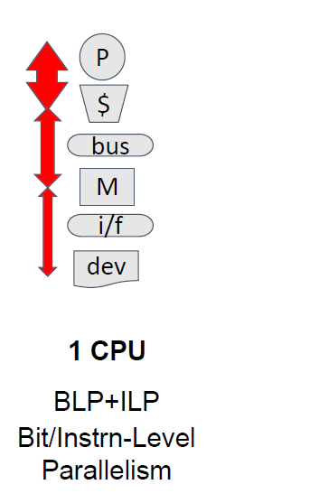
X-Level Parallelism in Computer Architecture
Notes:
BLP: 32-> 64 bit

Slide 25
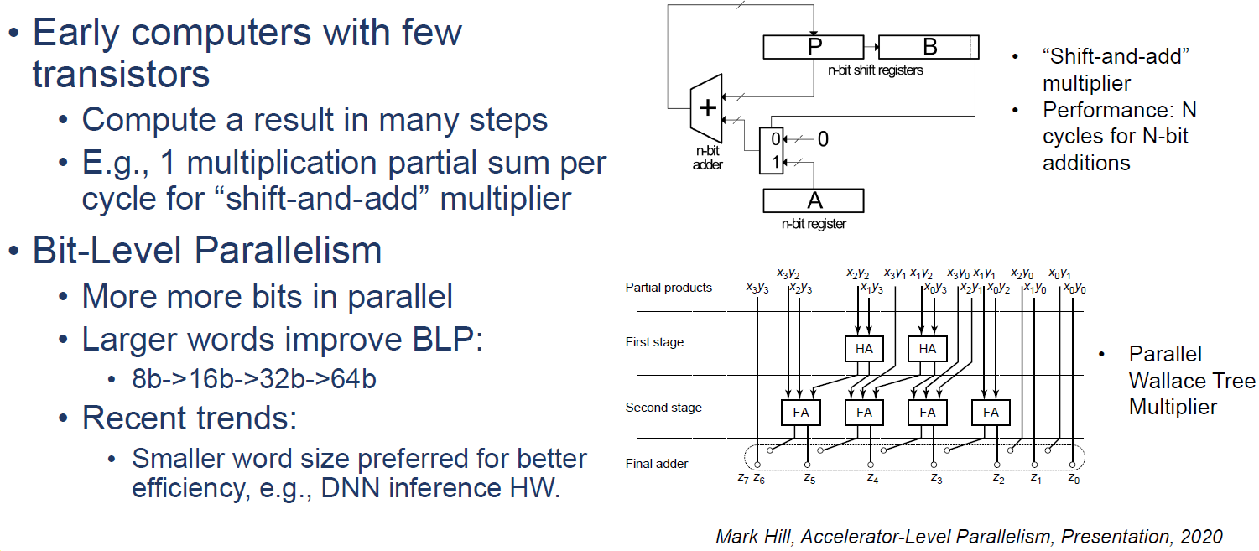
Bit-Level Parallelism (BLP)
Notes:
4004 4比特
Reverse trend of blp 现在都用8比特

Slide 26
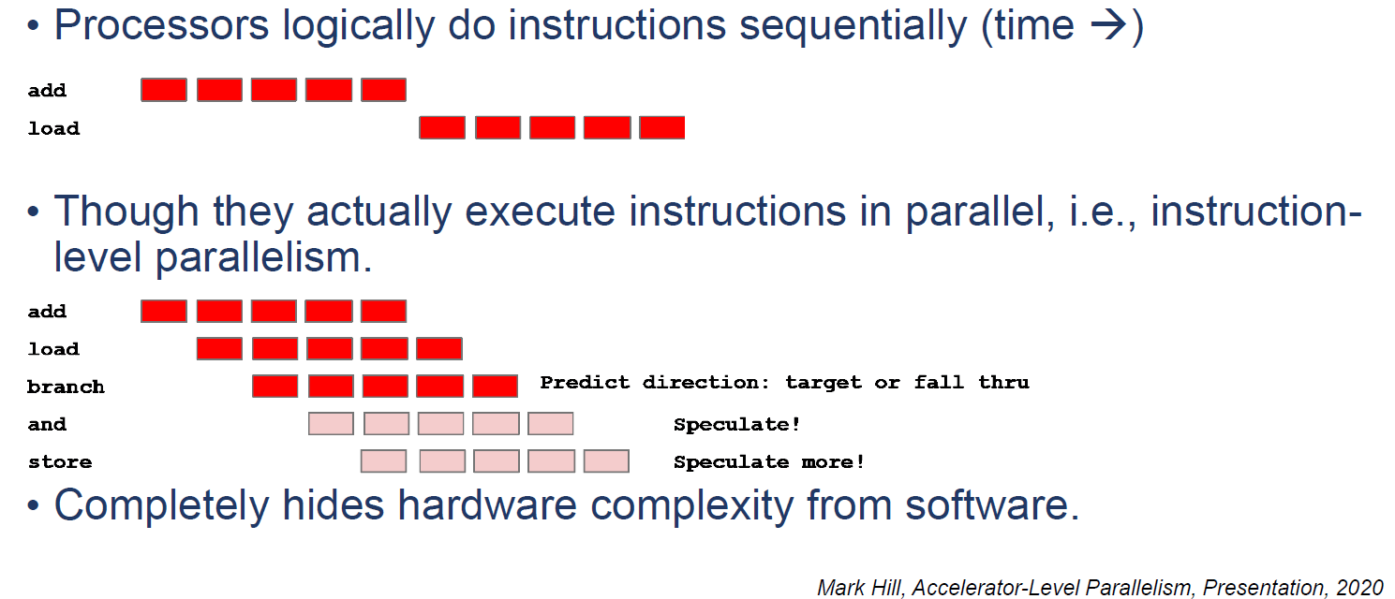
Instruction-Level Parallelism (ILP)
Notes:
ILP是无感的
很多的programmability overhead是为了支持pipeline

Slide 27
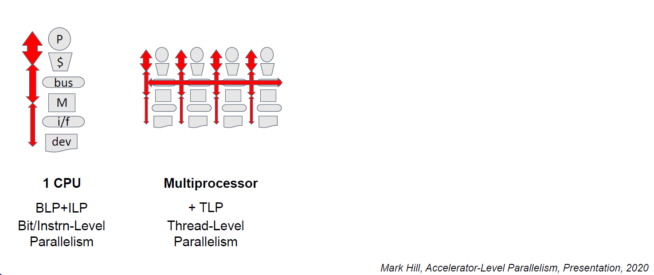
X-Level Parallelism in Computer Architecture
Notes:
基本上讲，在ILP之后，我们就需要越来越多的软硬件接口和协同设计了。
TLP之间的同步

Slide 28
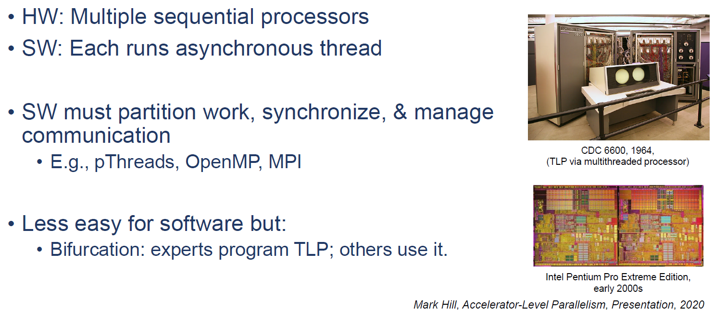
Thread-Level Parallelism (TLP)
Notes:
Bifurcation：分歧

Slide 29
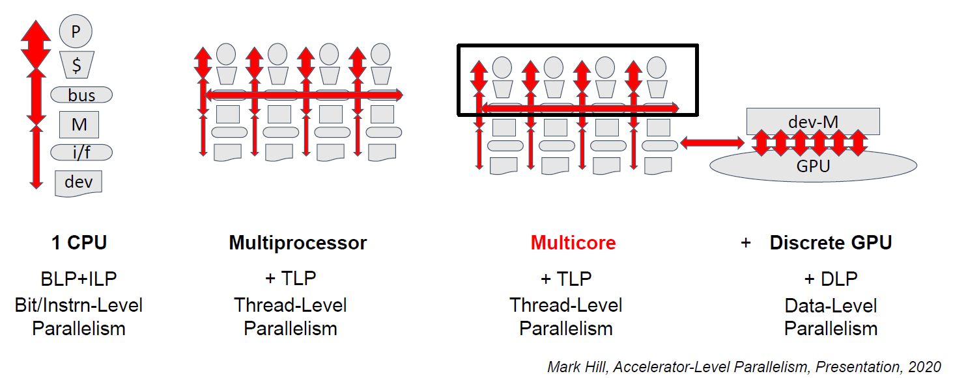
X-Level Parallelism in Computer Architecture

Slide 30
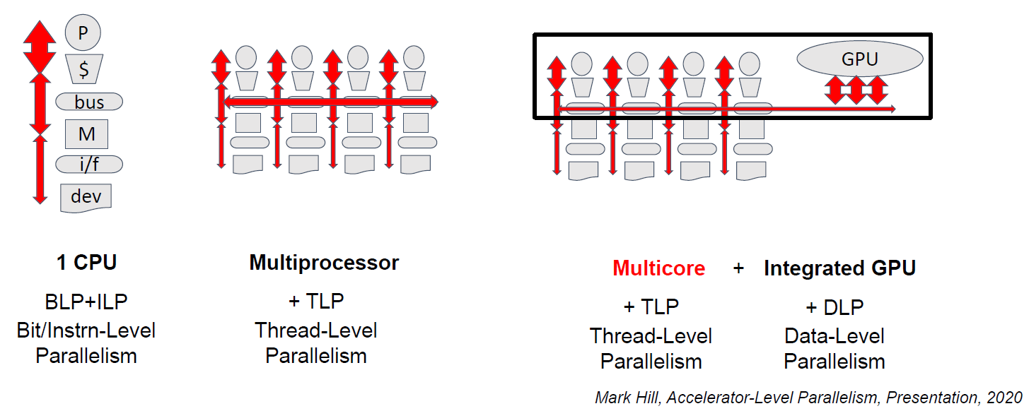
X-Level Parallelism in Computer Architecture

Slide 31
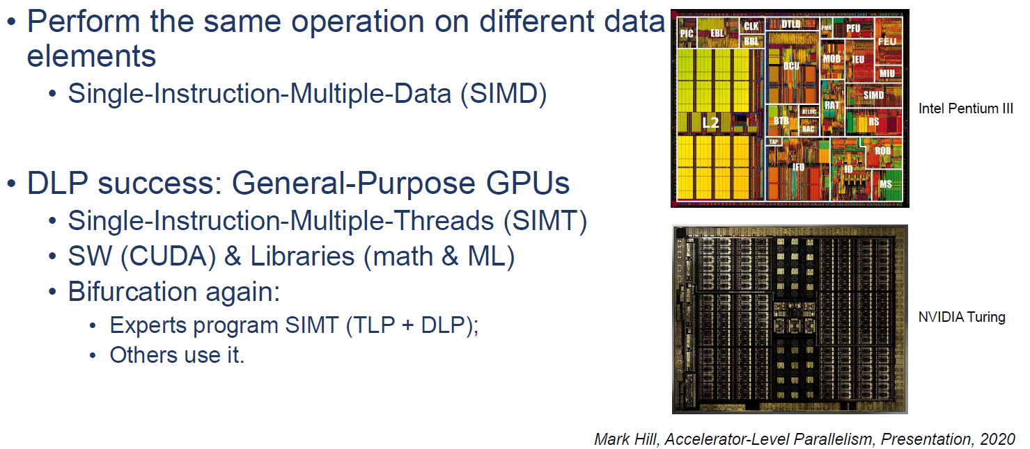
Data-Level Parallelism

Slide 32
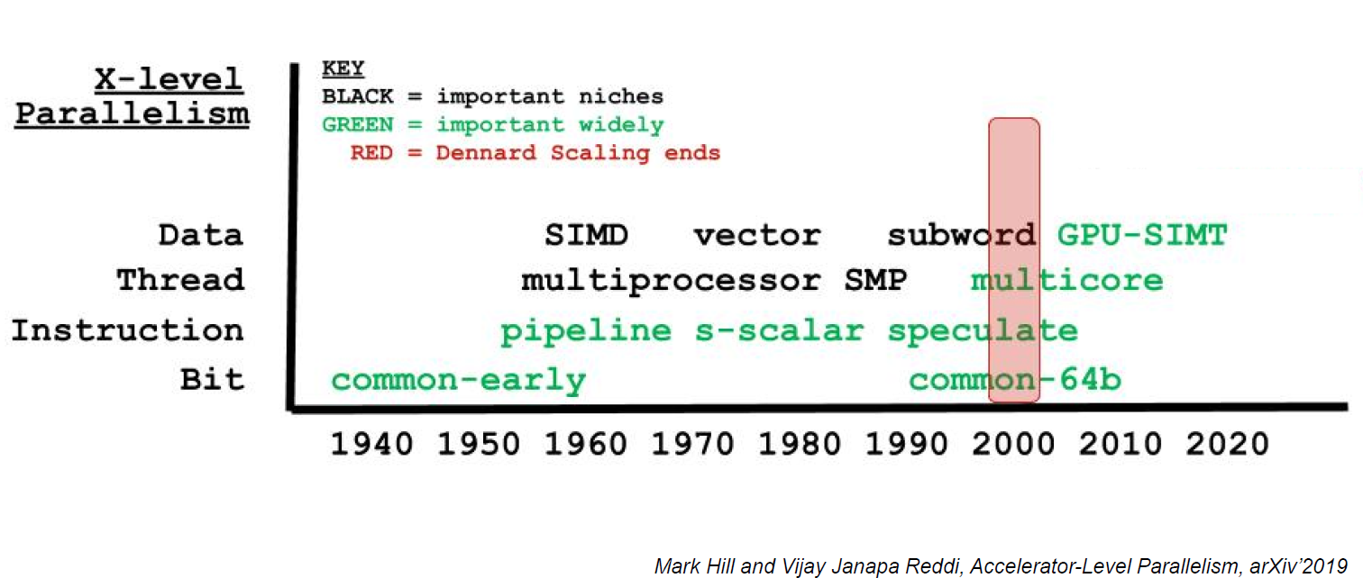
X-Level Parallelism in Computer Architecture
Notes:
以TPU为例讲一下2010年之后的发展
Speculate: 预测性计算，分支预测、数据预测等等

Slide 33
Outline
End-to-End Deployment
  AI Processing Pipeline
  Practical Constraints:
  Thermal, Performance Variability, Interference
Accelerator-Level Parallelism (ALP)
  X-level Parallelism
  ALP in Mobile SoC
  Open Challenges

Slide 34
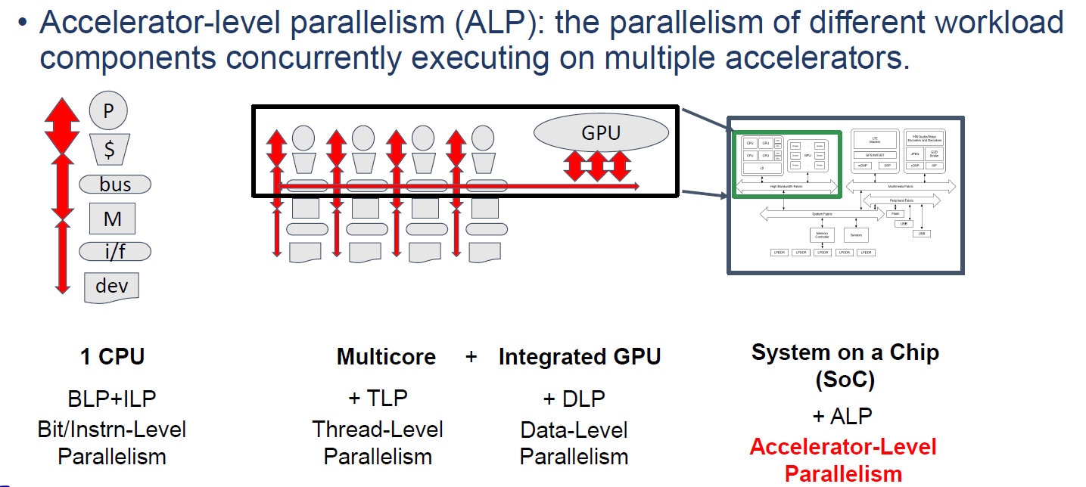
X-Level Parallelism in Computer Architecture
Notes:
SoC，经常有CPU、GPU、NPU的集成
Nvidia为例 （CUDA、TensorRT等等）
纵向集成

Slide 35
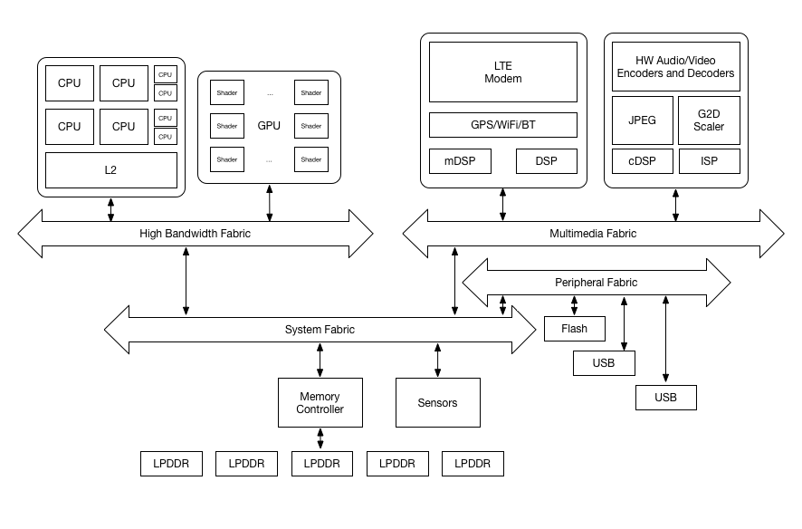
Mobile SoC HW

Slide 36
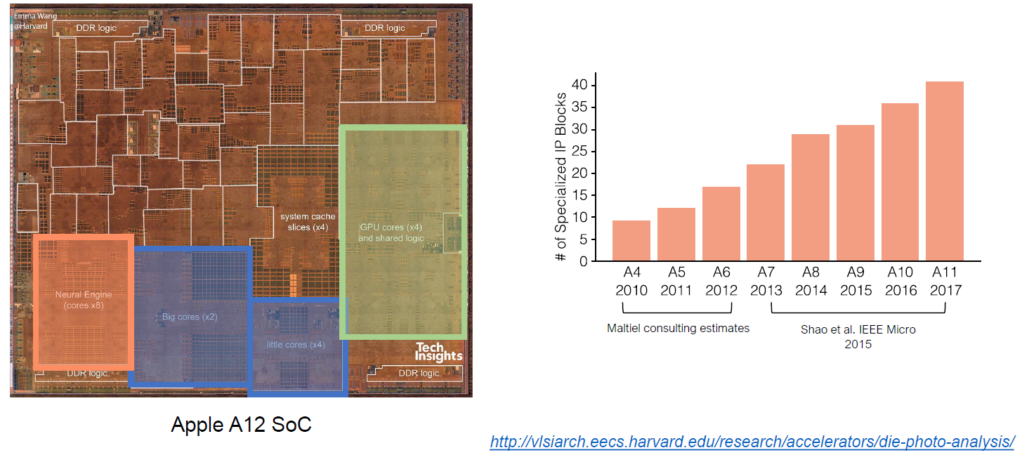
CPU, GPU, and Accelerators

Slide 37
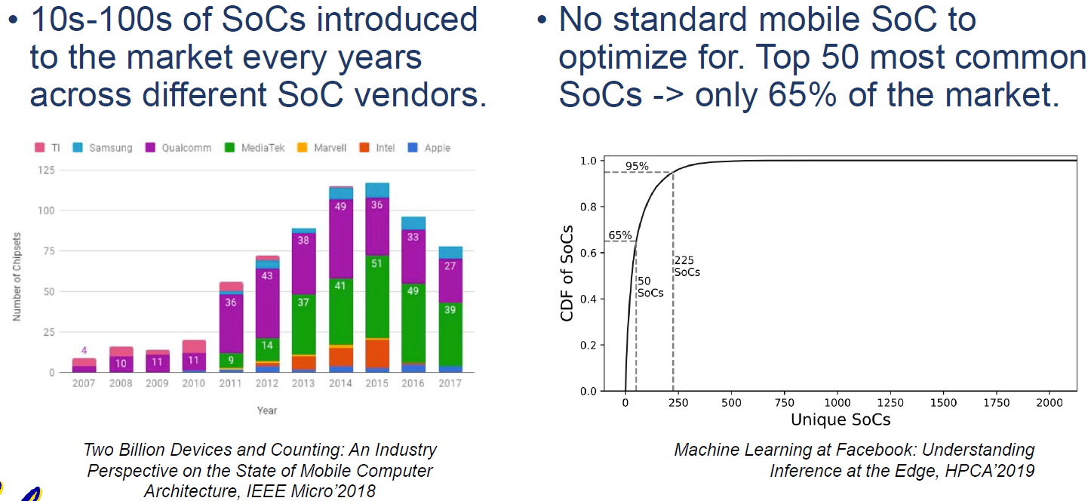
Mobile SoC Diversity

Slide 38
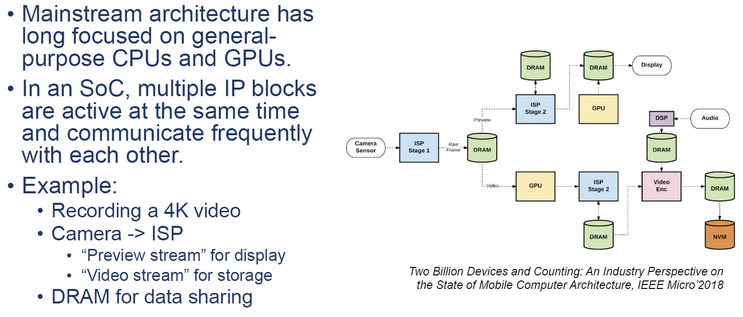
Mobile SoC Usecase
Notes:
对焦什么的，还要智能算法

Slide 39
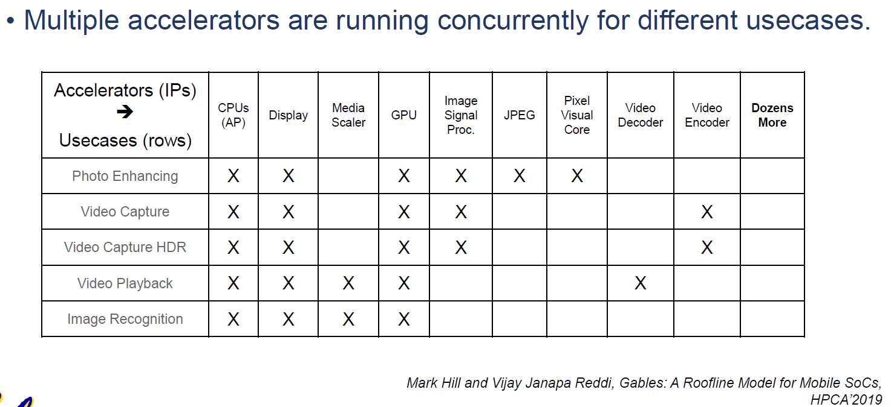
Mobile SoC Usecase

Slide 40
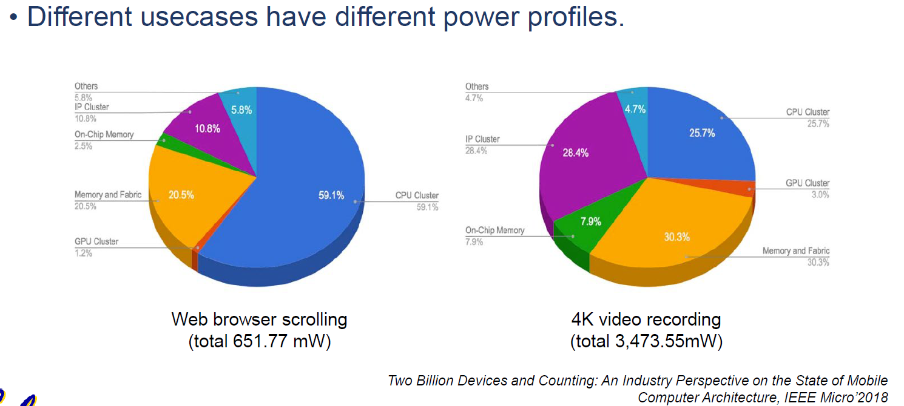
Mobile SoC Usecase
Notes:
优化目标完全不一样。

Slide 41
Outline
End-to-End Deployment
  AI Processing Pipeline
  Practical Constraints:
  Thermal, Performance Variability, Interference
Accelerator-Level Parallelism (ALP)
  X-level Parallelism
  ALP in Mobile SoC
  Open Challenges

Slide 42
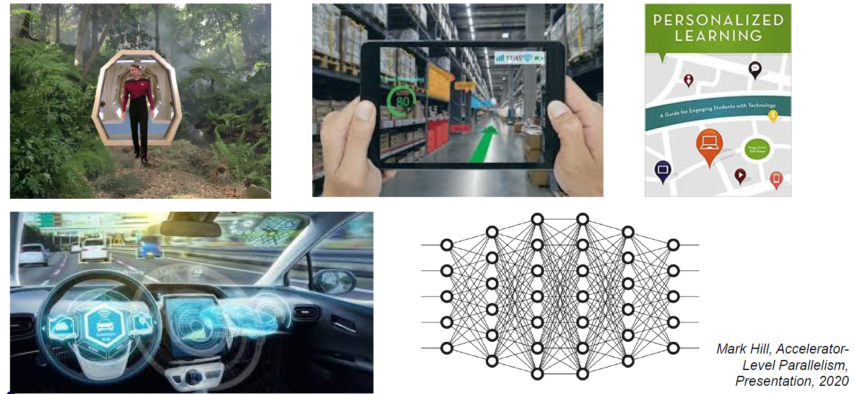
Future Apps Demand Much More Computing

Slide 43
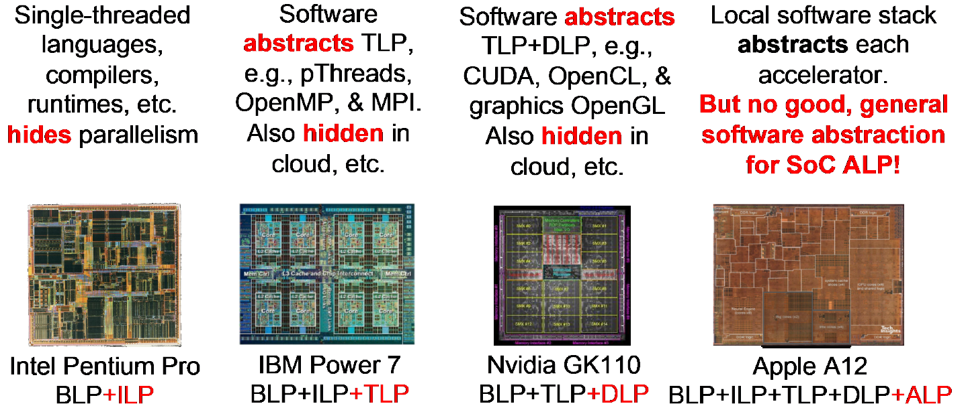
X-level Parallel Hardware + Software (Model)
Notes:
如何切分任务，很关键
Abstraction ISA，现在没有了

Slide 44
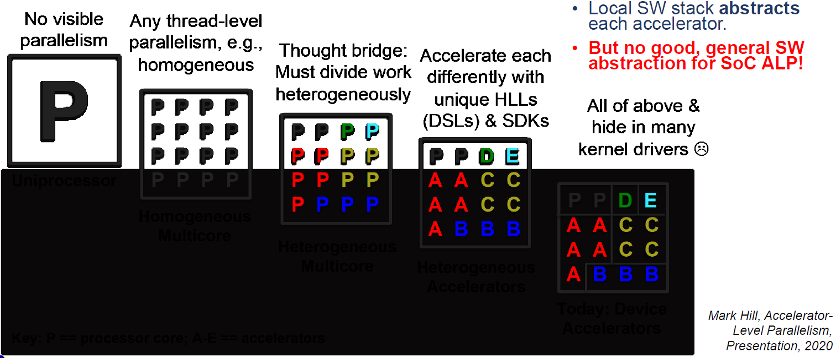
ALP Challenges & Opportunities
Uniprocessor
Homogeneous
Multicore
Heterogeneous
Multicore
Heterogeneous
Accelerators
Today: Device
Accelerators
Notes:
很难有一个统一的已用的抽象
现在的问题是不同的IP之间都有自己的libraries，ISA，从上层绕道隔离

Slide 45
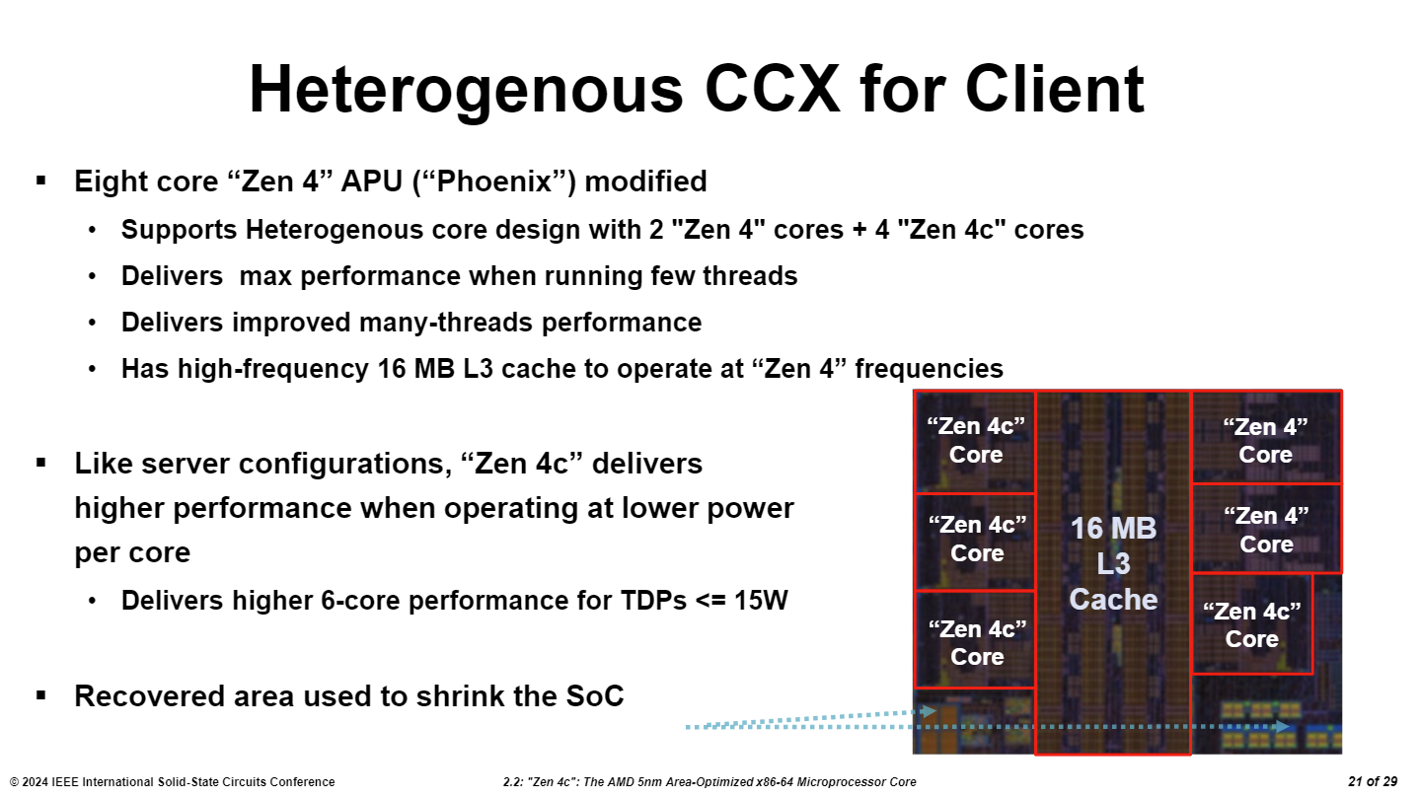
ALP Challenges & Opportunities
Notes:
很难有一个统一的已用的抽象
现在的问题是不同的IP之间都有自己的libraries，ISA，从上层绕道隔离

Slide 46
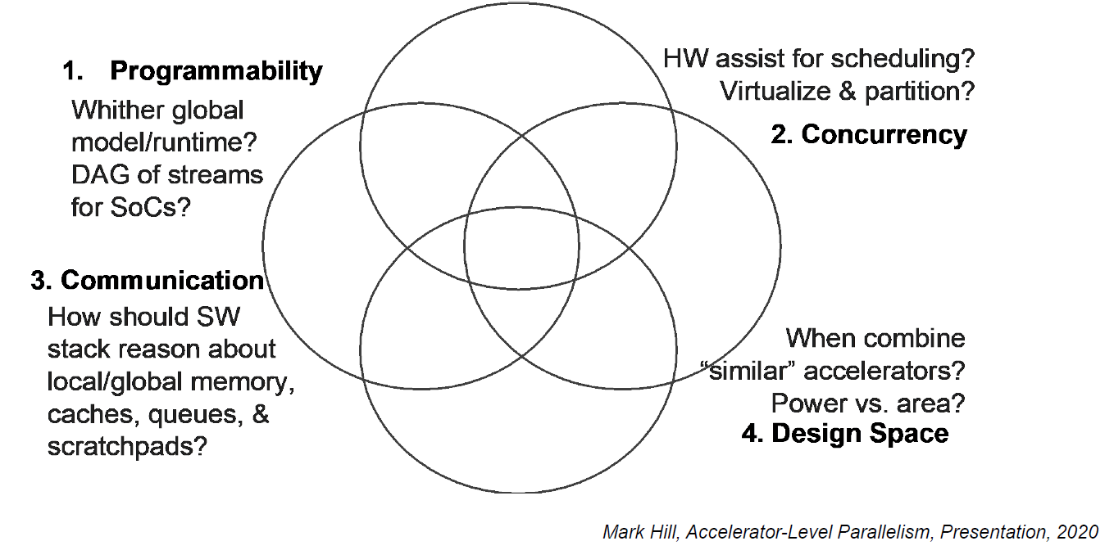
ALP Challenges & Opportunities

Slide 47
Review
End-to-End Deployment
  AI Processing Pipeline: pre/post ML processing
  Practical Constraints: end-to-end consideration
  Thermal, Performance Variability, Interference
Accelerator-Level Parallelism (ALP)
  X-level Parallelism: BLP/ILP/TLP/DLP
  ALP in Mobile SoC: diversity
  Open Challenges:
  programmability, concurrency, communication, DSE

